Slide 1
Backend Testing

Slide 2
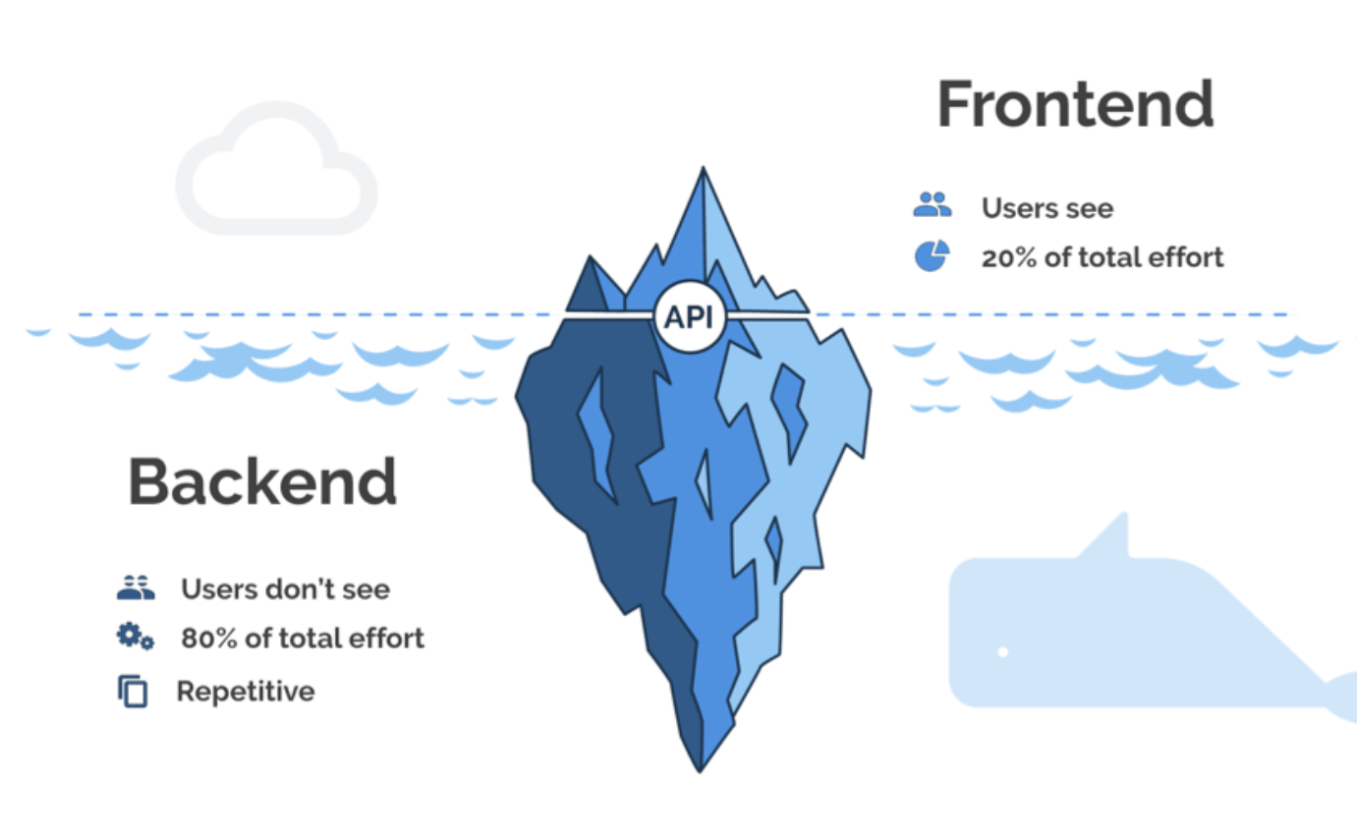
Backend is any part of a software that user do not see
If front end is the skin of a software application, backend is the meat and bones that is keeping it up and running.

Slide 3
API (Application Program Interface) is:
A Contract
An Abstraction
A Specification
Model for information exchange
Used to generate Consumers in multiple languages.
Used in business integrations.
https://developer.twitter.com/en/docs/platform-overview

Slide 4


Testing API mostly involves testing the contract(pact) between the producer and consumer
Each pact is a collection of interactions

Slide 5
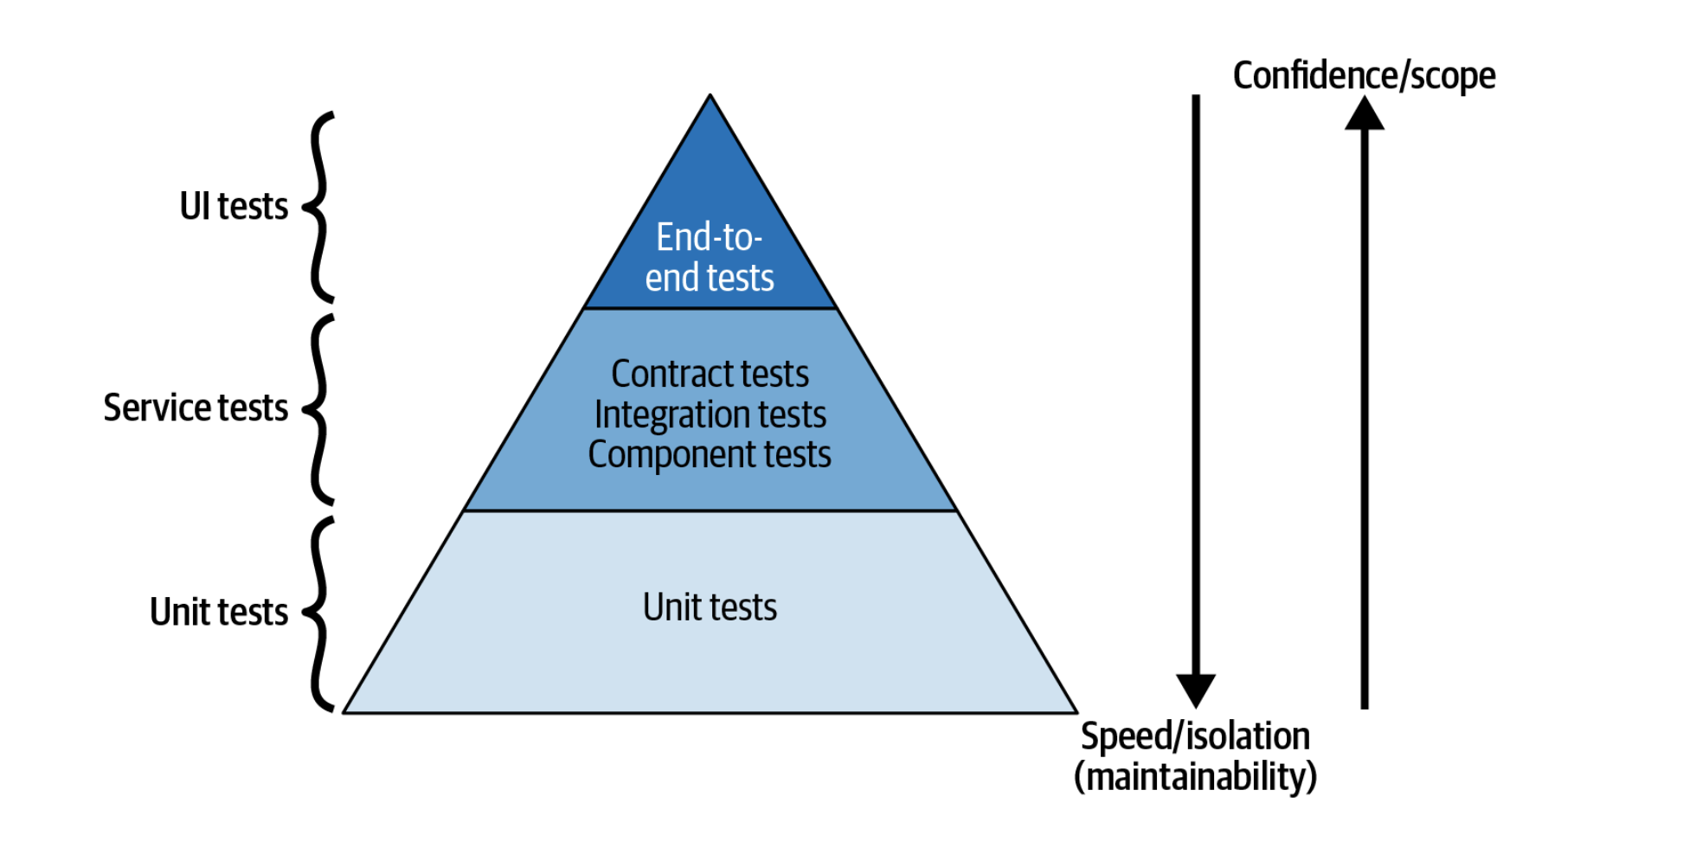
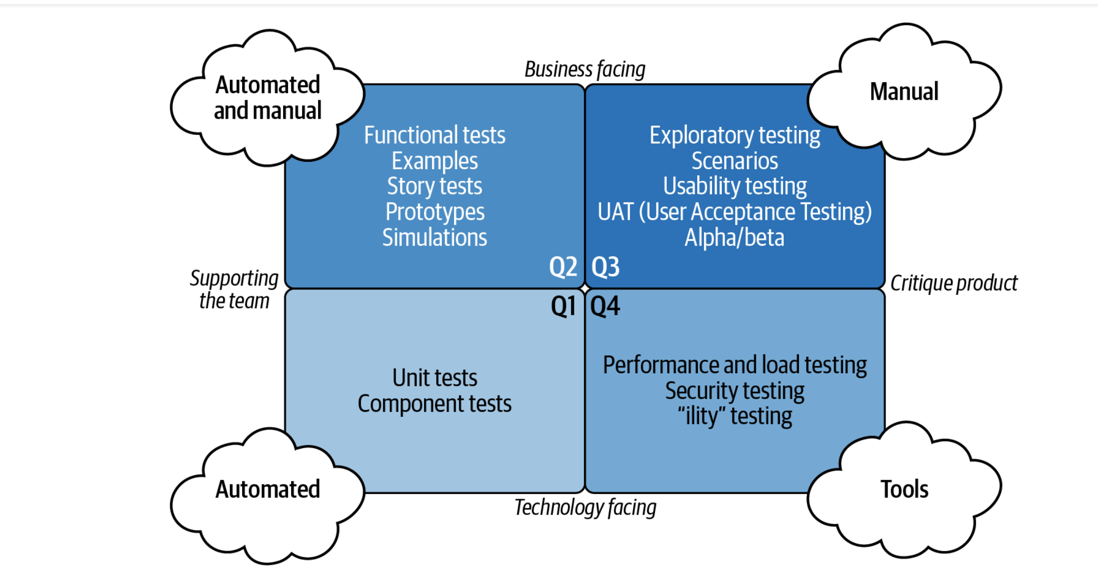
Testing Strategies
Test pyramid
Test Quadrant

Slide 6
Service tests make up the middle tier of the pyramid. They will provide you with more confidence that your API is working correctly than unit tests, though they are more expensive. The expense comes from the tests having a larger scope and less isolation, which incurs a higher maintenance and development cost.
Service tests include some of the following cases: the verification that multiple units are working together, that behaviour is as expected, and that the application itself is resilient. Therefore, service tests fit into Q1, Q2, and Q4 of the test quadrant.
One type of test is not better than another—the test pyramid is a guide to the proportions of each type of testing you should aim to implement. It can be tempting to ignore the test pyramid and concentrate on end-to-end testing as this gives a high degree of confidence. However, this is a fallacy and instead gives a false sense of security that these higher-level tests are of higher quality/value than unit tests. The fallacy gives rise to the ice cream cone representation of testing, which is the opposite of a test pyramid.

Slide 7
https://github.com/pact-foundation/pact-go
https://docs.pact.io/faq/convinceme
https://learning.oreilly.com/library/view/mastering-api-architecture/9781492090625/ch02.html#idm46213

